Slide 1
HINDGUT DEVNT
Dr Kaisha
Senior Lecturer

Slide 2
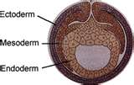
Normal Embryology
Endoderm
Epithelial lining and glands
Mesoderm
Lamina propria, muscularis mucosa, submucosa, muscularis externa and serosa
Ectoderm
Enteric nervous system and posterior luminal digestive structures
Notes:
The germ layers are present by the 2nd week and include endoderm, mesoderm and ectoderm. The zygote forms a solid mass of cells, the morula, by the process of mitotic division. The solid ball becomes a blastocyst with two layers. Following implantation the third layer, the endoderm, is created. The inner layer becomes the mesoderm and the top layer the ectoderm. In humans, germ tissues formed during gastrulation is the basis of all tissues and organs.
Endoderm - Epithelial lining and glands
Mesoderm - Lamina propria, muscularis mucosae, submucosa, muscularis externa and serosa
Ectoderm - Enteric nervous system and posterior luminal digestive structures

Slide 3
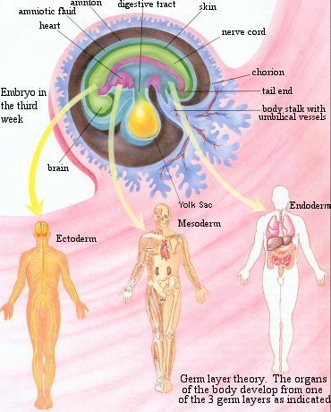
Normal Embryology
Images from: http://ehumanbiofield.wikispaces.com/AP+Development+HW

Slide 4
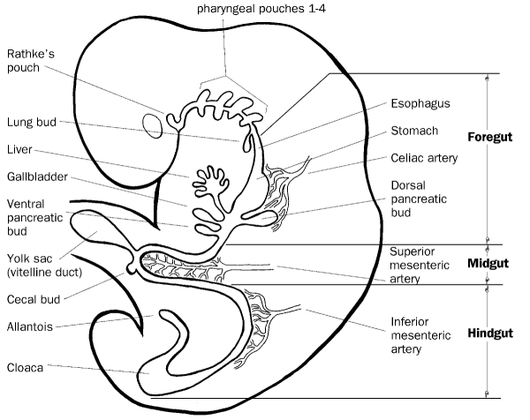
Normal Embryology
Primitive Gut Tube –
Incorporation of the yolk sac during craniocaudal and lateral folding of the embryo.
Foregut
Midgut
Hindgut
Image from http://www.med.umich.edu/
Notes:
The Primitive gut tube develops in weeks 3-4 by incorporating the yolk sac during the craniocaudal and lateral folding of the embryo. The tube is divided into 3 distinct sections; foregut, midgut and hindgut. Foregut gives rise to the esophagus, stomach, liver, gallbladder, bile ducts, pancreas and proximal duodenum. The midgut develops into the distal duodenum, jejunum, ileum, cecum, appendix, ascending colon, and proximal 2/3 of transverse colon. The hindgut becomes distal 1/3 of the transverse colon, descending colon, sigmoid colon and the upper anal canal.

Slide 5
Canalization
Canalization
Week 5 - Endoderm portion of GI tract proliferates
Week 6 - Occlusion of the lumen
Week 8 - Recanalization due to cell degeneration
Abnormalities in this process
Stenosis/Atresia
Duplications
Notes:
Proliferation of the epithelial lining of the gut tube results in obliteration of the lumen by week 6. The central cells then degenerate and the tube is re-canalized by week 8. Abnormalities in this process result in: stenosis, atresia, and duplications.

Slide 6
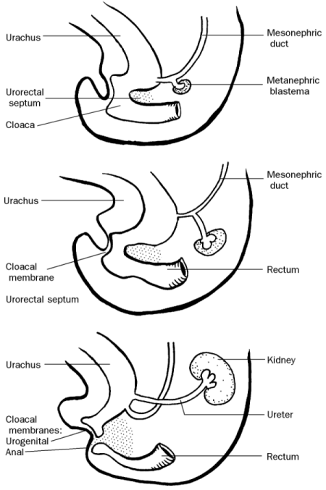
Hindgut
Distal 1/3 of the transverse colon, descending colon and sigmoid colon develop from the cranial end of the hindgut.
Upper anal canal develops from the terminal end of the hindgut with the urorectal septum dividing the upper anal canal and the urogenital sinus.
http://www.med.umich.edu
Notes:
Colonic Development
The distal 1/3 of the transverse colon, descending colon and sigmoid colon develop from the cranial end of the hindgut. The upper anal canal develops from the terminal end of the hindgut with the urorectal septum dividing the upper anal canal and the urogenital sinus during 6th week. By the 7th week, the urorectal septum fuses with the cloacal membrane, giving rise to the anal membrane and the urogenital membrane. The anal membrane ruptures during the 8th week allowing communication between the anal canal and the amniotic fluid. The superior 2/3 of the anal canal originates from hindgut and the inferior 1/3 is derived from proctodeum. The pectinate line is the junction of proctodeum ectoderm and hindgut endoderm.

Slide 7
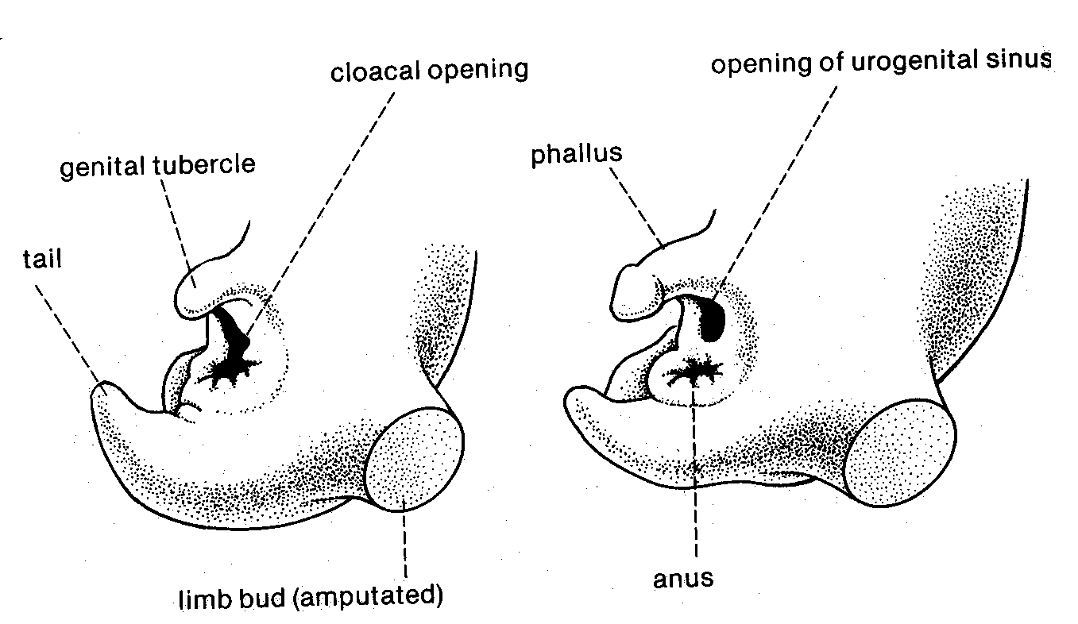
Embryology of the imperforate anus
Between 4-6 weeks, the cloaca becomes the common depository for the developing urinary, genital and rectal systems.
The cloaca is quite promptly divided into an anterior urogenital sinus and a posterior intestinal canal by the urorectal septum.
Two lateral folds of cloacal tissue join the urorectal septum to complete the separation of the urinary and rectal tracts.
Notes:
7

Slide 8
Development of rectum and upper ½ of anal canal
Origin:
Endoderm of hindgut→ mucosa & glands.
Splanchnic secondary mesoderm→ submucosa & musculosa.

Slide 9
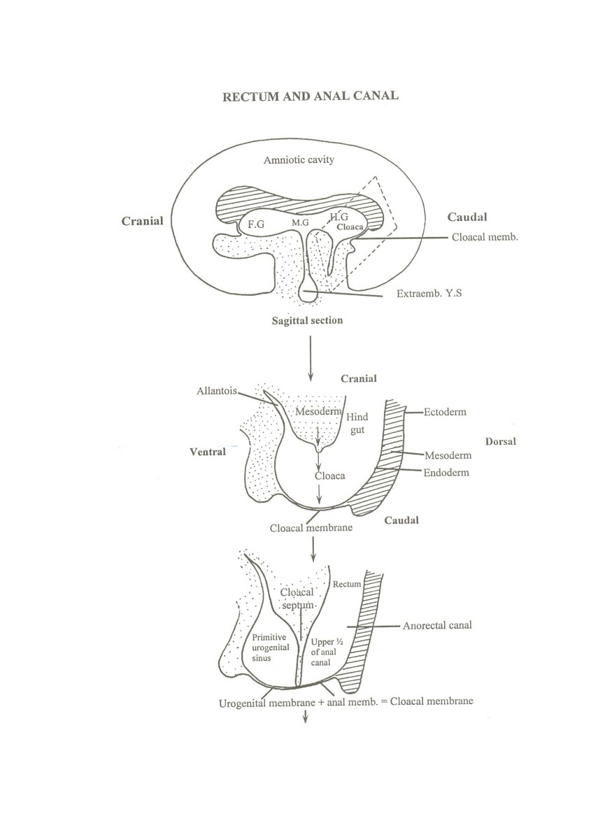
Development:
The cloaca ( dilated caudal part of hindgut) is divided by cloacal septum into:
1- A dorsal part ( anorectal canal).
2- A ventral part ( primitive urogenital sinus).

Slide 11
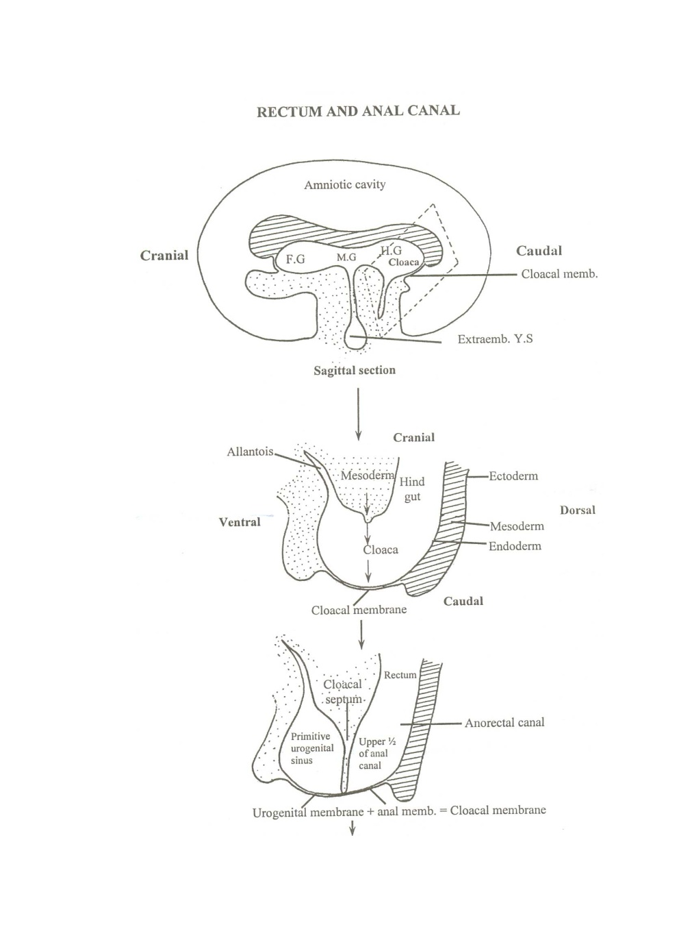
The anorectal canal gives the rectum and upper 1/2 of anal canal.
The rectum will be convoluted due to unequal growth of its walls.

Slide 12
Development of lower half of anal canal
Origin:
Ectoderm → Stratified columnar epithelium.
Splanchnic secondary mesoderm → submucosa, musculosa and anal sphincters.
So, the upper ½ of anal canal is endodermal and its lower half is ectodermal .

Slide 13
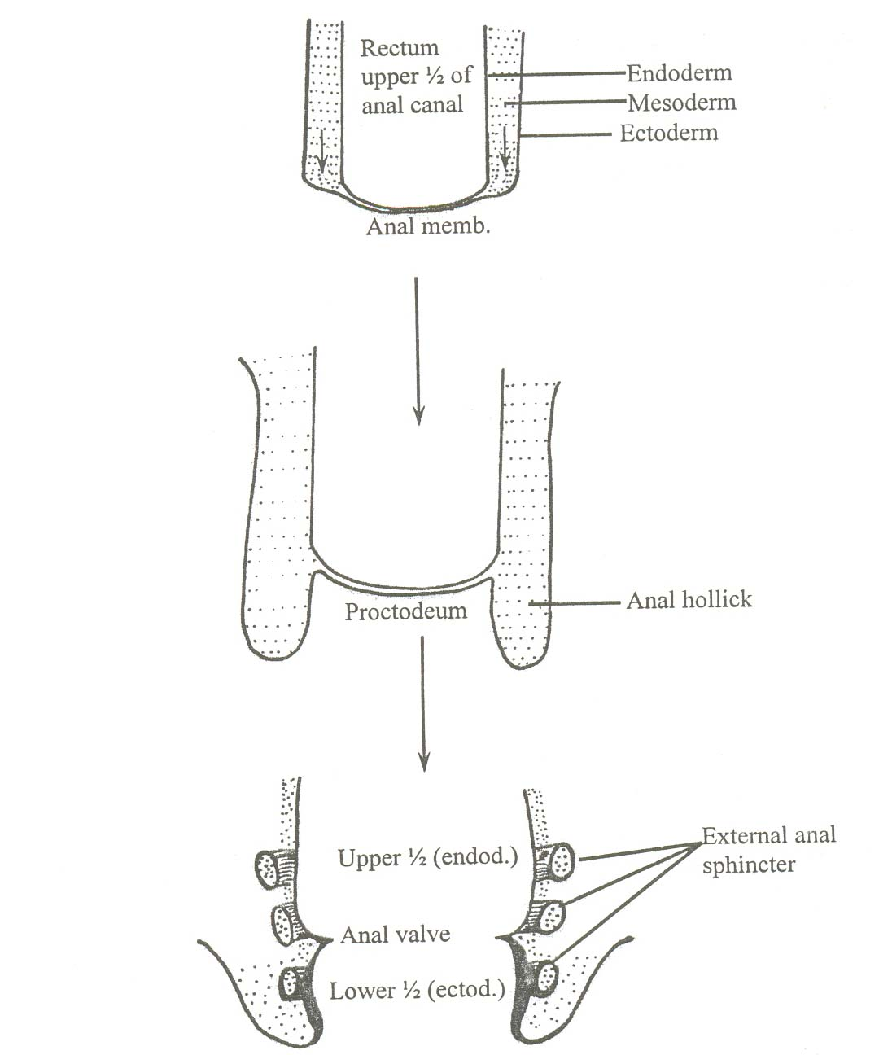
Development of Anal Canal
Mesenchyme around anal membrane proliferates producing elevations of the surface ectoderm called anal hillocks.
The anal membrane is now located at the bottom of an ectodermal depression called proctodium ( primitive anal canal)→ lower ½ of anal canal.
The anal membrane ruptures leaving remnants as anal valves and the two halves of anal canal are continueous with each other.

Slide 14
Hindgut Anomalies
Clinical Correlation
Anorectal agenesis occurs if the urorectal septum does not develop appropriately.
VACTERL Association
Vertebral anomalies, anal defects, cardiac defects, TEF, Renal and Limb defects
Hirschsprung disease – failure of the neural crest cells to form the myenteric plexus (see Enteric Nervous System).

Slide 15
Proctodeum
The posterior ectodermal portion of the alimentary canal is formed in the embryo by invagination of the outer body wall.
Becomes the lower 1/3 of the anal canal

Slide 16
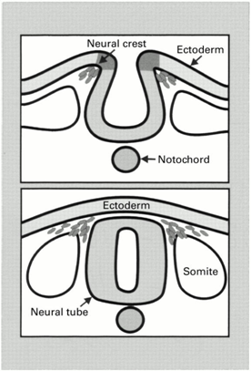
Enteric Nervous System
Collection of neurons in the GI tract.
Controls motility, exocrine and endocrine secretion and microcirculation.
Regulates immune and inflammatory process.
Functions independent of CNS.
Image from: Young. Gut 2000

Slide 17
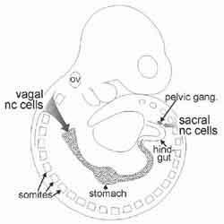
Development of Enteric Nervous System
Primarily derived from the vagal segment of neural crest cells.
Cells initially migrate to the cranial section and then caudally
Hindgut ganglia receive contributions of cells from the cranial and sacral segments of the neural crest cells
Interstitial cells of Cajal arise from the local gut mesenchyme
Image from: http://www.landesbioscience.com/curie/chapter/2823/
Notes:
The enteric nervous system (ENS) originates from neural crest cells. The neural crest cells arise between the neural plate and the epidermal ectoderm along the entire rostrocaudal extent of the embryo. The cells migrate to the dorsal midline forming the neural tube. The neurons of the ENS derive from these neural crest cells. Melanocytes, the sympathetic and parasympathetic ganglia all originate from the same cells as the ENS.
Neural crest cells migrate during the 5th and 12th week of gestation, down to the anal canal. Cells from the sacral segment of neural crest cells migrate from the sacral segment to the hindgut during weeks 6 to 12. The myenteric plexus develops first followed by the submucous plexus. As the gut lengthens and increases in diameter, the cells form ganglia, the functional unit of the ENS.
Interstitial cells of Cajal arise from the local gut mesenchyme and not from the neural crest cells.

Slide 18
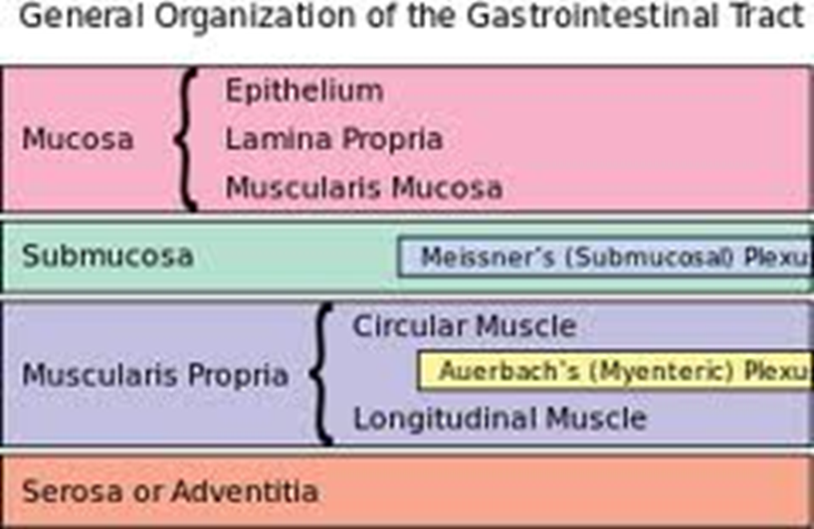
Development of the Enteric Nervous System
Nerve cell bodies are grouped into ganglia
Ganglia are connected to bundles of nerves forming two plexus
Myenteric (Auerbach’s)
Submucosal (Meissner’s)
http://en.wikipedia.org/wiki/Enteric_nervous_system
Notes:
Innervation by vagal and sympathetic nerves.
Myenteric plexus (Auerbach’s plexus) between outer longitudinal and middle circular layers.
Submucosal plexus (Meissner’s plexus) between circular muscular layer and the mucosa.

Slide 19
Enteric Nervous System
Myenteric plexus
Lies between the circular and longitudinal muscles
Regulates
Motility
Secretomotor function to mucosa
Connections to
gallbladder and pancreas
sympathetic ganglia
esophageal striated muscle

Slide 20
Enteric Nervous System
Submucosal plexus
Lies between circular muscle layer and the muscularis mucosa
Regulates:
Glandular secretions
Electrolyte and water transport
Blood flow
Similar structure found in gallbladder, cystic duct, common bile duct and the pancreas

Slide 21
Enteric Nervous System
Clinical Correlations:
Motility
Achalasia
Psuedo-obstruction
Hirschsprung’s disease
Secretions
Cholera
E. Coli

Slide 22
Hirschsprung’s Disease
Congenital disorder
1:5000 live births
Failure of neural crest cells to colonize the entire gut resulting in an aganglionic zone
Tonic constriction of aganglionic section
Long (20%) and Short Segment (80%)
Short segment 4:1 male:female
Isolated anomaly in 70% of cases
Multiple genes and modifier genes identified
Not mendelian

Slide 23
Genetics of Hirschsprung’s Disease
Associated genes encode members of the glial cell neurotrophic factor family
involved in signaling pathways
transcription factors
Genes identified
GDNF
Ret
EDNRB
Sox10
Notes:
Recent studies have identified multiple genes and modifier genes. The identified genes encode members of the Glial cell neurotrophic factor family and are involved in signaling pathways or are transcription factors.
Genes identified
Ret
GDNF
EDNRB
Sox10
Ret is a receptor tyrosine kinase with a strong association with HD. Ret dimerizes when activated by a member of the GDNF family and a glycophosphatidylinositol-anchored co-receptor. Ret stimulates enteric neural crest-derived cells to migrate, survive and differentiate. 70% of HD cases are associated with a Ret mutation.

Slide 24
Genetics of Hirschsprung’s Disease
Glial Cell-Derived Neurotrophic Factor (GDNF)
Member of TGF-β superfamily
Binds to and activates receptor tyrosine kinase (Ret)
Defects on GDNF/Ret signaling account for
50% familial cases
30% of sporadic cases
Notes:
Glial Cell-Derived Neurotrophic Factor (GDNF) is a family of extracellular signaling molecules and is a member of TGF-β superfamily. GDNF binds to and activates receptor tyrosine kinase (Ret). Defects in GDNF/Ret signaling account for 50% familial cases and 30% of sporadic cases.

Slide 25
Genetics of Hirschsprung’s Disease
Endothelin 3 (Et-3) is a secreted protein expressed by gut mesenchyme.
Et-3 signals via Endothelin receptor B (Ednrb)
Ednrb is expressed on migrating enteric neural crest cells
Mutations in Et-3 and Ednrb account for 5% of cases
Notes:
Endothelin 3 (Et-3) and Endothelin receptor B (Ednrb) have also been implicated in the development of HD. Et-3 is a secreted protein expressed by gut mesenchyme that signals via Endothelin receptor B (Ednrb), which is expressed on migrating enteric neural crest cells. Mutations in Et-3 and Ednrb account for 5% of HD cases

Slide 26
Genetics of Hirschsprung’s Disease
Sex determining region Y – box 10 (Sox10) is a high mobility group transcription factor.
Expressed on migrating enteric neural crest cells
Mutations of Sox10 account for 5% of cases
Notes:
Sex determining region Y – box 10 (Sox10) is a high mobility group transcription factor. It is expressed on migrating enteric neural crest cells. Mutations of Sox10 account for 5% of cases.

Slide 27
Genetics of Hirschsprung’s Disease
Gene Interactions have been identified in isolated Mennonite populations and mouse models.
Ret and Ednrb
Ret and Et-3
Sox10 and Et-3/Ednrb
Mechanisms are unknown –
?Downstream signaling
Notes:
The severity of HD is variable. This is an indication of incomplete penetrance suggesting modifier genes, which have been identified. Gene Interactions have been identified in isolated Mennonite populations and in mouse models. The mechanisms remain unknown, but are thought to reflect downstream signaling. Identified interactions include: Ret-Ednrb, Ret-Et-3, and Sox10 and Et-3/Ednrb.

Slide 28
Genetics of Hirschsprung’s Disease
Modifier Genes = Mutated gene that must be coupled with another mutation to result in or enhance the effect.
Neuregulin 1 (NRG1) - associates with Ret
NRG1 signals receptors to regulate neural crest cell development. The receptor is also associated with Sox10
Modifiers have also been identified for Sox10 and Et-3 and Ednrb
Notes:
Modifier genes are mutated gene that must be coupled with another mutation to result in or enhance the effect. An example of a modifier gene is Neuregulin 1 (NRG1) which associates with Ret. NRG1 signals receptors to regulate neural crest cell development. Sox10 also associated with NRG1. Additional modifiers have also been identified for Sox10, Et-3 and Ednrb.

Slide 29
Genes in Gastrointestinal Embryology
Homeobox-containing transcription factors (Hox genes) – play a role in gut regionalization
Sonic Hedgehog (Shh) – transcription factor controls endodermal-mesenchymal interactions
Defects associated with TEF and Anorectal malformations
Possible role in IBD and Malignancy
Notes:
In addition to the role of genes in disease process, such as HD, the interplay of genes in gastrointestinal embryology is increasingly uncovered. Homeobox-containing transcription factors (Hox genes) have been identified as critical genes in gut regionalization. These genes control cellular events, with different Hox genes found in different tissues (i.e. – Hoxa3 in foregut and Hoxc5 in hindgut). Hox genes are vital to gut patterning along the AP axis to include gross morphology and epithelial differentiation. Sonic Hedgehog (Shh) is a transcription factor that controls endodermal-mesenchymal interactions. Defects in Shh are associated with TEF and anorectal malformations. It has also been proposed that defects play a role in development of IBD and malignancy.

Slide 30
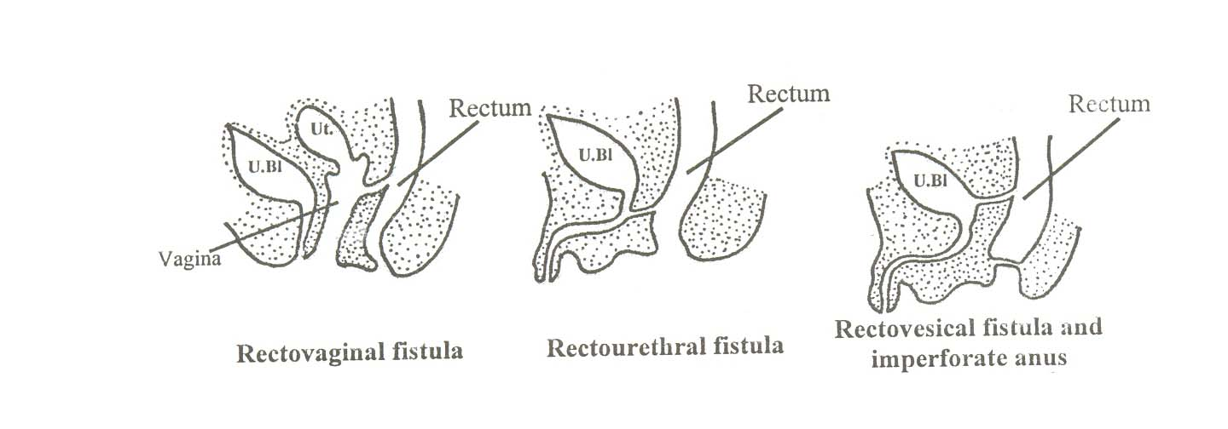
Congenital anomalies:
1- Fistulae formation: (Rectovaginal, rectouretheral, rectovesical, anouretheral and anovaginal fistula) due to incomplete development of cloacal septum.
2- Rectal atresia: due to either abnormal canalization or defect in blood supply causing focal atresia.

Slide 31
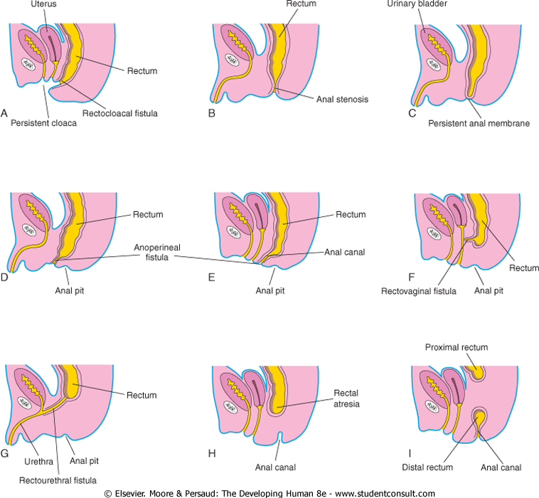

Slide 32
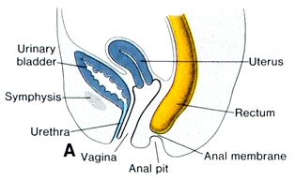
3- Imperforate anus: due to failure of rupture of anal membrane .

Slide 33
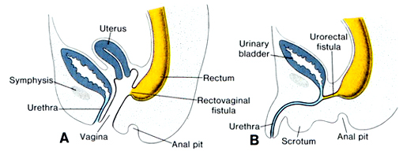
4- Anal stenosis: due to dorsal deviation of the cloacal septum as it grows caudally→ small anal canal.
5- Anal agenesis: it terminates blindly. It is associated with a fistula between rectum and urinary bladder , urethra or vagina.

